Slide 1
Reinforcement Learning for Taxi-out Time Prediction: An improved Q-learning Approach
Prepared by : Ahmed Aly Hassan
ID : 192006

Slide 2
Agenda
Introduction & Business POV
Literature review RL & Linear Regression
Proposed Method
Data Source
Explanation of variables
Q-learning algorithm
Final Results
Conclusion

Slide 3
Introduction & Business POV
Flights undergo a large percentage of delay between scheduled departure of an aircraft and actual takeoff. This not only leads to passenger resentment but also, results in emission of harmful pollutants that adversely affect the environment.
A novel Q- learning algorithm is proposed to predict the accurate taxi-out times at a specific airport. Operational data is analyzed using the Markov Decision Process (MDP) after which a reinforcement learning methodology for Q-learning is formalized for the estimation of taxi-out time of flights. The predicted taxi-out time result is then compared with the actual taxi-out time of the next set of data.
(IATA) classifies flight delays into various categories like Passenger and baggage delays, Aircraft and ramp handling delays caused due to loading and servicing equipment, fueling and de-fueling, ground handling operations impaired due to weather, Air Traffic Flow Management Restrictions (ATFM), Reactionary delays, etc.
The On-Time Performance analysis (OTP) of major hub airports like New Delhi, Mumbai depicts that among these delays, ATFM, due to taxi-out time delays in particular contributes to 20% of total flight delay

Slide 4
Introduction & Business POV
Apart from that, for every delayed minute at the airport, the responsible airline also has to shell out huge amounts of parking charges
The quantities of fuel burned as well as different pollutants are a function of the taxi times of aircraft.
using high-speed tugs that can be used to move aircraft between the terminal gate and runway more efficiently for reducing these emissions
A major function of Aircraft Communication Addressing and Reporting System (ACARS) is to automatically detect and report changes to the major flight phases such as the Out of the gate phase, Off the ground phase, On ground phase, and Into gate phase).
Taxi-out time of a flight is calculated as Off time subtracted from Out time. If an aircraft is scheduled to depart at 3:00 am, the brakes at the wheels of the aircraft are released at 3:00 am. The aircraft taxis from the ramp along the taxiway to the runway where it takes off at 3:12 am. Therefore, the taxi-out time taken is 12 minutes.

Slide 5
Introduction & Business POV
The accurate taxi-out time prediction will lead in fulfilling the estimated block and flight time and thus maintaining the On Time Performance of flights. Apart from that, the airlines will be able to cater to the single largest operating cost, i.e. fuel cost. Also, during peak hours, the passengers, Air Traffic Control (ATC) authorities, ground operations and pilots have to have a Collaborative Decision Making (CDM) process that would facilitate a smooth departure of the flight.
The IATA put forth a handbook consisting of IATA codes in order to specifically assign accountability for various delay reasons.
Predicting accurate taxi-out time has significant challenges because of the dynamic airport configurations and unexpected weather changes.
(RL) approach needs to be implemented which when applied on the MDP model would encourage exploration of a more accurate prediction of taxi-out times.

Slide 6
Literature review-Reinforcement Learning
prediction space: for predicting the taxi-out time a machine learning approach is used as a ϵ A where A denotes the prediction space.
state variables : The airport system state is represented in the form of a Markov chain, where X denotes the system state space. x={x1, x2, x3, x4, x5} are the state variables.
The decision to predict the taxi-out time based on the system state is formulated as a Markov Decision Process (MDP). For solving the MDP, it is necessary to discretize X and A
the utility function (reward) R(x, a) is updated based on the r(x, a, j) which is the difference between the actual and predicted taxi-out values. Updating of R(x, a) is done as follows, where time t is replaced with iteration number n.
R^{n+1}(x,a)=(1-α) R^{n}(x,a)+α[r(x,a,j)+βmin R^{n} (j,b)
where, α is the learning parameter that is decayed over time and β is the discount parameter

Slide 7
Literature review-Linear Regression
linear regression technique is used as a baseline to compare the results of the Q-learning approach.
takeoff queue size estimate is obtained by predicting the amount of passing aircrafts that it may experience on the airport surface while it is taxiing out, and by considering the number of takeoffs between pushback time and its takeoff time.
. Least squares regression helps in estimating the regression coefficients, yielding estimated coefficients β_{1….} β_{p.} The predicted y value is given by, y’ = β₀ + β₁x1 + β₂ x2…… β_{n}xn
The difference between y and y’ is called the residual e
where e is given by : e = y – y’
The weights, or regression coefficients, can be estimated by using the least square approach

Slide 8
Proposed Method
Q-learning is a model-free reinforcement learning technique. Specifically, Q-learning can be used to find an optimal action-selection policy for any given (finite) Markov Decision Process (MDP).
It gives the expected utility of taking a given action in a given state and following the optimal When such an action-value function is learned, the optimal policy thereafter.
One of the strengths of Q-learning is that it is able to compare the expected utility of the available actions without requiring a model of the environment.
Q-learning can handle problems with stochastic transitions and rewards, without requiring any adaptations. It has been proven that for any finite MDP, Q-learning eventually finds an optimal policy in the sense that the expected value of the total reward return over all successive steps, starting from the current state, is the maximum achievable.

Slide 9
Data Source
An example of the OOOI (Out, Off, On, In) data from the Daily Operations Report (DOR) of ACARS is generated similar to the DOR provided by the On Time Performance (OTP) team working at the Mumbai (BOM) airport.
training data is for March 2013 and testing data is for 7th April 2013.
cancelled flights, and the flights that have crossed the delay deadline by +15 minutes or -15 minutes are not considered at all
Block time = ON_TIME - OFF_TIME
Taxi-out time = OFF_TIME - OUT_TIME
Taxi-in time = IN_TIME - ON_TIME
FLT _ NO | FLT_ DATE | DEP | DEP_ TIME _DIF | OUT_ TIME | OFF_ TIME | ARR | ON_ TIME | IN_ TIM E | ARR_ TIME _DIF
243 | 12-03- 13 | DEL | 21 | 08:01 | 08:19 | KBL | 09:55 | 10:0 0 | 20
263 | 12-03- 13 | TRV | 75 | 08:40 | 08:53 | MLE | 09:41 | 09:4 9 | 84
337 | 12-03- 13 | CCJ | -12 | 05:18 | 05:41 | MCT | 08:58 | 09:0 4 | -1
671 | 12-03- 13 | MA A | 106 | 08:36 | 08:51 | IXM | 09:35 | 09:4 1 | 111
…
…

Slide 10
Explanation of variables
x1 denotes the time spent in the runway queue.
x2 denotes the number of departure aircraft taxiing along with the reference aircraft, Longer the departure queues, higher the taxi-out delays. As the delay increases, the departure queue increases as well.
x3 is the number of arrival aircraft taxiing along with the reference aircraft.
x4 is the average taxi time.
x5 denotes the time of day.
x6 is the parameter that denotes the departure time difference.
x7 is the arrival time difference.

Slide 11
Q-learning algorithm
Training phase:
1-Once the calculations of states, actions, and the reward scheme are given for input, the next step is to capture the airport’s t+90 minutes data
2-load the first 15 minutes flight data into a new sheet obtain the system state x Calculate reward R(x,a)
3-Simulate the new window of 15 minutes. Find the next state j for each flight. Compute r(x,a,j) using equation (1). Update reward R(x,a)
4-choose the action corresponding to the lowest non-zero R-value
5-Continue learning until all the flights in the window have been completed and until the error difference between actual and predicted taxi-out time is less than ε.
6-Once learning is complete, the optimal prediction for a given state x is the one that corresponds to the minimum non-zero R-value for that state.

Slide 12
Q-learning algorithm
Testing phase:
7-: Calculate the states variable x= x1, x2, x3, x4, x5, x6, x7 for new set of data which is to be used for testing
8-From this data, Calculate reward R(x,a) using equation(1) where x is the state and a is the action
9-The output obtained from the algorithm is tested for least difference of predicted taxi-out time and actual taxi-out time
Validation phase
10-testing phase is then validated by checking the values, whether they correspond with the departure time difference of each flight for the same day. This validation is done manually from the raw DOR report generated by ACARS as a ‘.xls’ file.

Slide 13
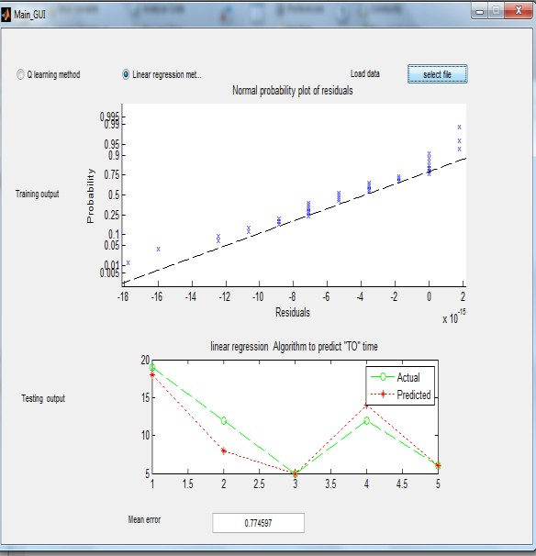
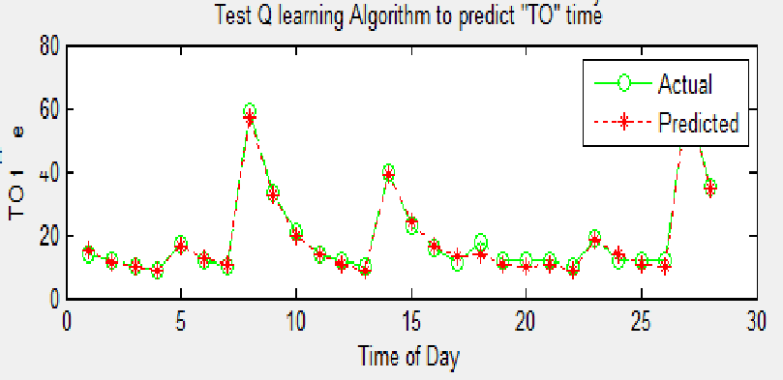
Final Results
Linear Regression
average testing error of linear regression for predicting taxi-out times = 0.7746min
Mean error = 4.21mins
Mean absolute error = 24.67mins
Relative absolute error = 0.07mins
Root mean square error = 52.32mins
Improved Q-learning
graph depicts vast number of variations between Actual and Predicted taxi-out time values.
The red line depicts the predicted taxi-out time and the green line predicts the actual taxi-out time.
Mean error = 0.76min
Mean absolute error = 1.12mins
Relative absolute error = 0.02min
Root mean square error= 1.38mins

Slide 14
Conclusion
Linear Regression computes an error of 4.21mins and Q-learning gives the least average error of 0.76mins
improved Q-learning helps in predicting taxi-out time and also reduces the taxi-out time error considerably.
offline batch reinforcement learning algorithm has been implemented with the help of Q-learning.
It utilizes the MDP to find the most optimal taxi-out time policy from a small number of previous taxi- out time experience cases.
The proposed method requires some initial data to export a good policy. Once the initial data is trained well, the testing gives the required results where the taxi-out error is least.
this research could be amalgamated into the decision making system where the air traffic controllers in the towers, pilots, and other bodies involved in the flight release can come over to Collaborative Decision Making

Slide 15
The end

